Slide 1

Tailoring Nanostructures on PEEK Film
Selected slides
Bert Müller
University of Basel and University Hospital Basel, Switzerland
2nd Global Biomedical Materials Congress
Shanghai, China, February 20-21, 2014

Slide 2
Outline
Plasma treatment allows preparing well-defined nanostructures.
PEEK films show anisotropic structure and properties.
Optical measurements allow detecting nanostructures of PEEK.
Nanostructures of PEEK influence stem cell differentiation.

Slide 3
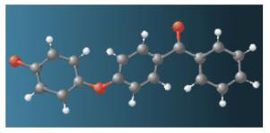
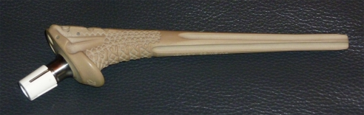
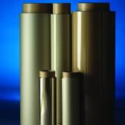


Polyetheretherketone (PEEK)
Biomaterial for trauma, orthopedic and spine applications, isoelastic to cortical bone, radiolucent / MR compatible, bioinert
PEEK hip stem
(Mathys AG, Bettlach)

Slide 4
Wide angle X-ray scattering of PEEK films

Slide 5
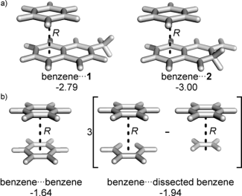
Anisotropic nanostructure of PEEK films – a model to explain results
0.12 eV = 2.8 kcal/mol
Bloom et al.: Angew. Chem. Int. Ed.
50 (2011) 7847
Long-range order 14.6 nm

Slide 6
Anisotropy of PEEK films as function of thermal treatment (hot embossing)
J. Althaus, H. Deyhle, O. Bunk, P. Kristiansen, B. Müller
Anisotropy in polyetheretherketone films
Journal of Nanophotonics 6 (2012) 063510

Slide 7
Plasma treatment-induced nanostructures on PEEK substrates
SEM images obtained after plasma treatment, power indicated

Slide 8
Roughness characterization using atomic force microscopy
J. Althaus et al.: Nanostructuring polyetheretherketone for medical implants, European Journal of Nanomedicine 4 (2012) 7-15

Slide 9
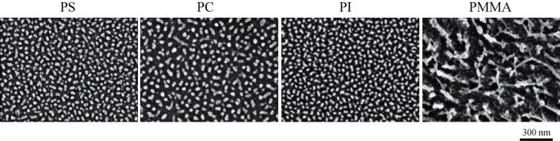
Nanostructuring polymer films
Whereas polystyrene (PS), polycarbonate (PC) and polyimide (PI) give rise to circularly shaped nanostructures polymethyl metacrylate (PMMA) substrates show large ramified nanostructures with an arm width comparable to the diameter of the compact morphologies of the other polymer films investigated.
J. Althaus et al.: Micro- and nanostructured polymer substrates for biomedical applications, Proceedings of SPIE 8339 (2012) 83390Q

Slide 10
Zeta potential measurements of plasma-treated PEEK
J. Althaus et al.: Micro- and nanostructured polymer substrates for biomedical applications, Proceedings of SPIE 8339 (2012) 83390Q

Slide 11
Protein adsorption on plasma-treated PEEK films
J. Waser-Althaus et al.: Differentiation of human mesenchymal stem cells on plasma-treated polyetheretherketone, Journal of Materials Science: Materials in Medicine (2014) DOI: 10.1007/s10856-013-5072-5

Slide 12
hMSC seeding including stimulation via cell medium composition
Cell seeding at Passage 4
20’000 cells/cm²
Unstimulated (US)
Osteogenic stimulation (OS)
Adipogenic stimulation (AS)
J. Waser-Althaus et al.: Differentiation of human mesenchymal stem cells on plasma-treated polyetheretherketone, Journal of Materials Science: Materials in Medicine (2014) DOI: 10.1007/s10856-013-5072-5

Slide 13
Microscopy approach
J. Althaus et al.: Nanostructuring polyetheretherketone for medical implants, European Journal of Nanomedicine 4 (2012) 7-15

Slide 14
Cell proliferation
J. Waser-Althaus et al.: Differentiation of human mesenchymal stem cells on plasma-treated polyetheretherketone, Journal of Materials Science: Materials in Medicine (2014)
DOI: 10.1007/s10856-013-5072-5

Slide 15
Conclusions
The anisotropy of semi-crystalline PEEK films originates from the lamellar stacks and can be demonstrated using optical and X-ray measurements.
Transmission measurements reveal the intermolecular binding energy of annealed PEEK films.
Plasma treatment allows nanostructuring PEEK substrates (and other polymers) and often uncovers the molecular orientations of polymer chains in injection-molded materials.
10 W oxygen plasma treatment is a promising activation method for osseointegration of PEEK implants in vivo, minimizing competing differentiation effects.

Slide 16














